Slide 1
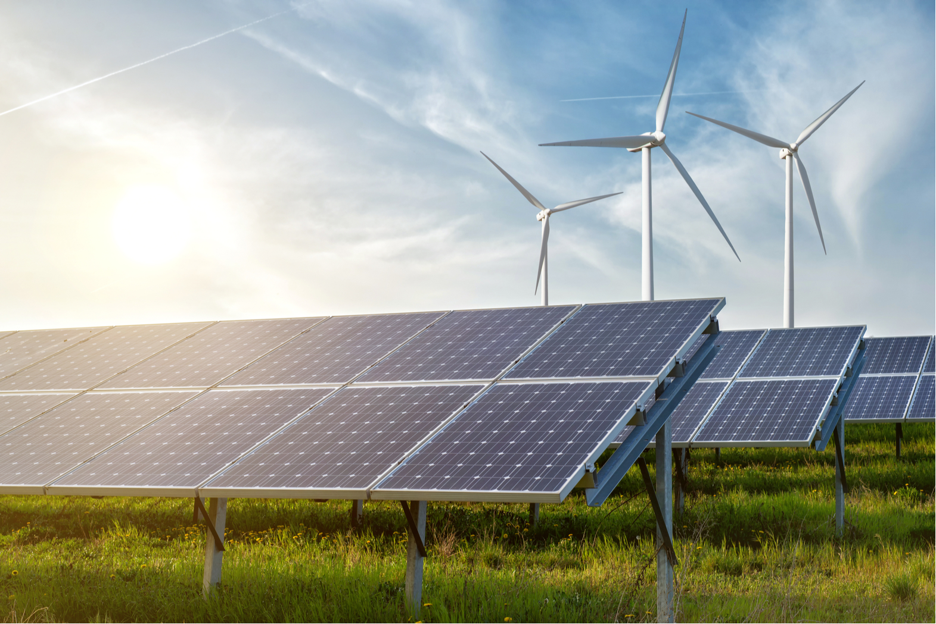


Data Science:
Finding Ideal Locations for Green Energy
Lena Kögel, Sönke Maibach, Gabriel Sacher, Simon Schad, Laura Marie Schiffers
25.09.2021 | Mentor: Amine Jebari | TechLabs Düsseldorf

Slide 2
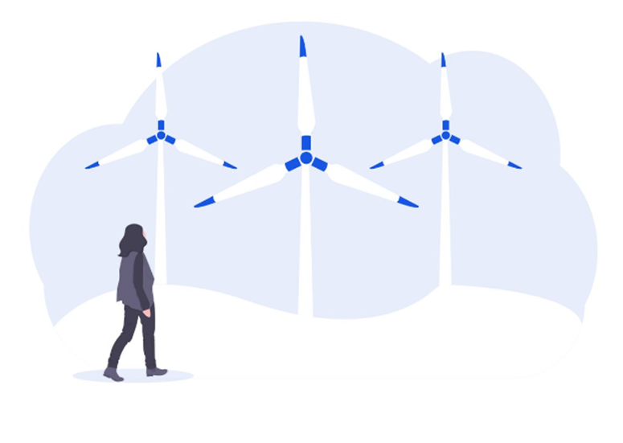

Data Science:
Finding Ideal Locations for Green Energy
Lena Kögel, Sönke Maibach, Gabriel Sacher, Simon Schad, Laura Marie Schiffers
25.09.2021 | Mentor: Amine Jebari | TechLabs Düsseldorf

Slide 3
Introduction Project Pitch Ideas
Analyse wind and solar data
Look at legal requirements as well as meterological data (wind speeds, sunlight hours, etc.) and consisting infrastructure (high voltage lines)
Show these locations a map (Highlight the best locations with a colour-ranking)
Optional: Calculate the amout energy that can be produced at a specific location
Optional: Calculate the break even-point
→ Goal: Recommend ideal locations for solar or wind parks

Slide 4
Working Steps Overview
Step 1
Step 2
Step 3
Step 4
Step 5
1.
2.
3.
4.
5.
TextTextText
TextTextText
TextTextText
TextTextText
TextTextText
TextTextText
TextTextText
TextTextText
TextTextText
TextTextText
TextTextText
TextTextText
TextTextText
TextTextText
TextTextText

Slide 5
First Headline Second Headline

Slide 6
First Headline Second Headline

Slide 7
First Headline Second Headline

Slide 8




First Headline Second Headline

